Slide 1
Drug repositioning of PKL in NAFLD
Student: Mengnan Shi
Supervisor: Cheng Zhang

Slide 2
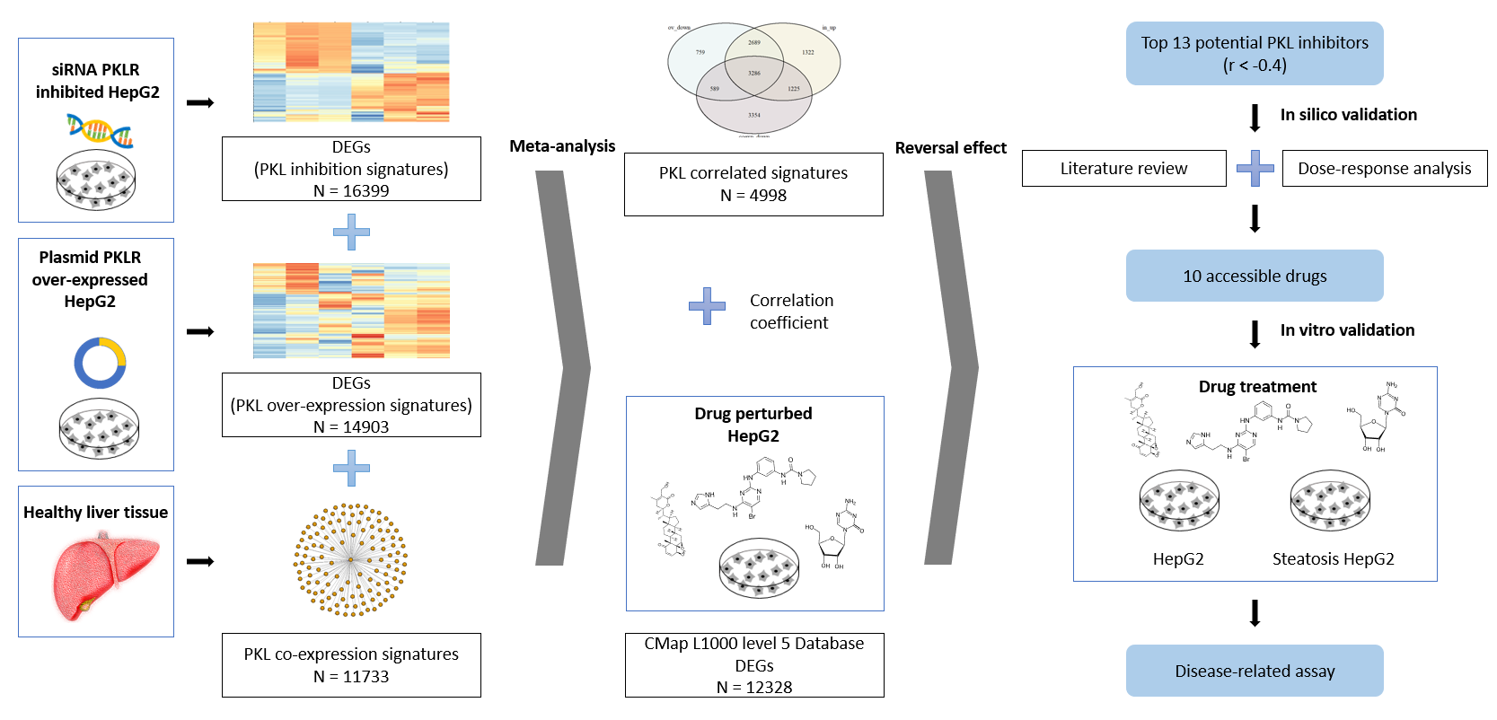
Flow chart

Slide 3
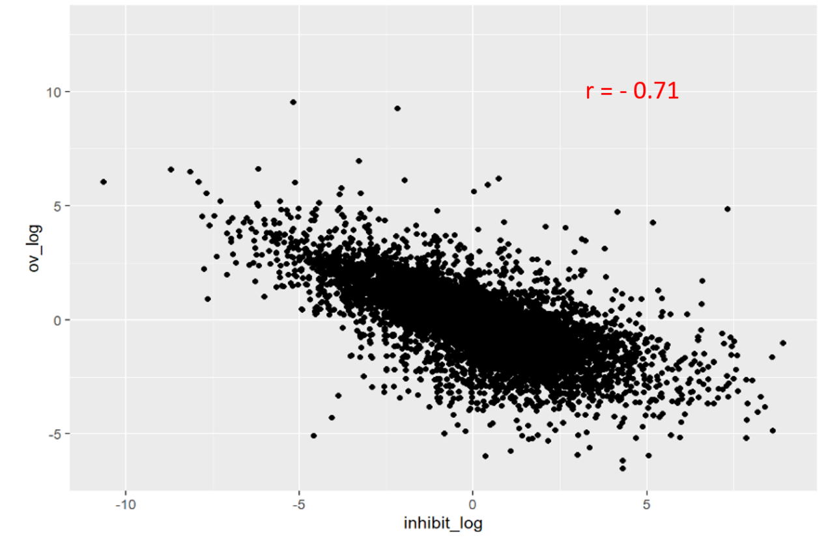
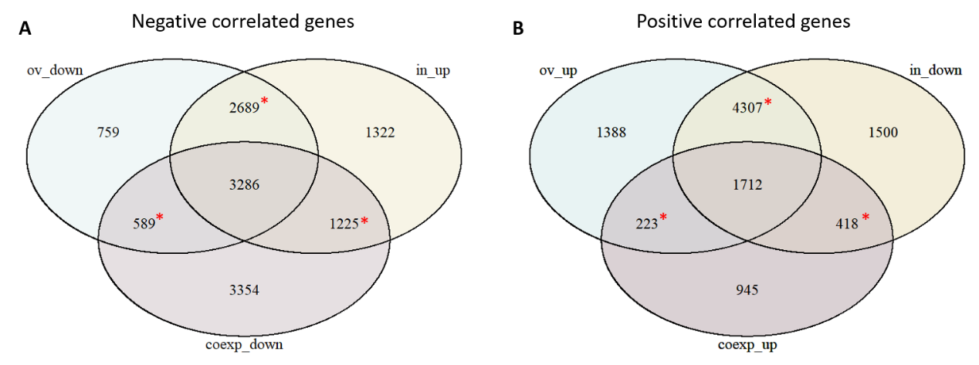
Transcriptomic data analysis result
A
C
B
Correlation coefficient of RNA-seq data of PKL siRNA inhibited HepG2 and plasmid overlapped HepG2 (P-value < 0.05)
Hypergeometric test of overlapped PKL correlated genes (*P-value < 0.05)
Gene set enrichment analysis of KEGG of 1712 PKL positively correlated genes. (P-value < 0.05)

Slide 4
Drug repositioning
Top 13 drugs according to the correlation coefficient between drug treated differential expressed gene signatures and PKL correlation gene signatures.
QL-XII-47 and Withaferin-A had a high correlation coefficient with non-PKL-expression cell lines as well, which means that the drug is not PKL-specific.
Dabrafenib and WZ-3105 had a negative correlation between drug ranking and drug dosages, which means that lower drug dosage had higher drug ranking. The results did not conforms to biological laws.

Slide 5
PubMed literature review of the 13 drugs

Slide 7
Protein content
A
WT HepG2:
6 of 10 drugs decreased PKL content after two-day treatment
Steatosis modeling HepG2
9 of 10 drugs decreased PKL content after one-week treatment
8 of 10 drugs decreased FASN content after one-week treatment
5 drugs showed positive results in all three assays
BX-912, JNK-IN-5A, PLX-4720, Azacitidine, AS-601245
*
*
*
*
*
*
B
C
*
*
*
*
*
*
*
*
*
*
*
*
*
*
*
*
*

Slide 8
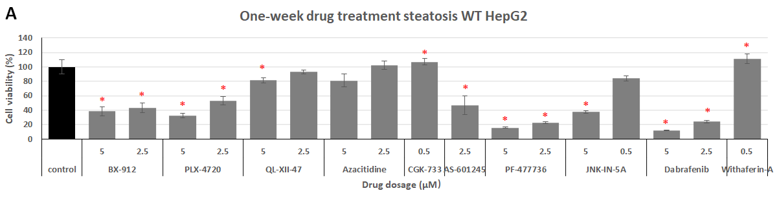
One-week steatosis cell viability
9 drugs reduced cell viability

Slide 9
Summary
 | WT HepG2 | Steatosis modeling HepG2
 | PKL | PKL | FASN | Cell viability
BX-912 | √ | √ | √ | √
PLX-4720 | √ | √ | √ | √
QL-XII-47 | × | √ | × | √
Azacitidine | √ | √ | √ | ×
CGK-733 | √ | × | √ | √
AS-601245 | √ | √ | √ | √
PF-477736 | × | √ | √ | √
JNK-IN-5A | √ | √ | √ | √
Dabrafenib | × | √ | √ | √
Withaferin-a | × | √ | × | √
BX-912, JNK-IN-5A, PLX-4720, AS-601245 have the potential to manage NAFLD.

Slide 10
One-week steatosis lipids content level
*
*
*
*
*
*
*
*
*
*
*
*
*
*
*
*
*
*
*
*
*
*
*
*
*
*
*
*
*
*
*
*
*
*
*
*
*
*
*

